Slide 2
Conflict in the Church
www.mackeynaz.org

Slide 3
Frequency of Conflict?
How often does conflict take place?
Should it be less frequent?
What kind of conflict should not take place?
Do we deal with different kinds of conflict differently?
Why is conflict so destructive?
Why is conflict so awkward?

Slide 4
Kinds of Conflict
What kinds of conflict are there?
Family
Interpersonal
Opinions
Truth
Political
Preference
Theological

Slide 5
Interpersonal Conflict Resolution
Matthew 18:15-20
Go to the person.
Take one or two witnesses.
Take it before the church.
Matthew 18:21-35
The unforgiving servant.
The master was angry because the forgiven servant refused to forgive.

Slide 6
Causes of Conflict
Different kinds of conflict?
Right vs
Wrong

Slide 7
Causes of Conflict
Different kinds of conflict?
Disagreement
Opinion
Preference

Slide 8
Causes of Conflict
Different kinds of conflict?
Different ways to accomplish the same thing.
Which is best?

Slide 9
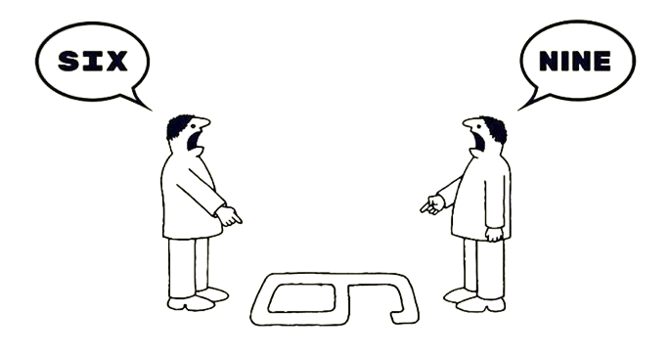
Causes of Conflict
Different kinds of conflict?
Perspective… both right?

Slide 10
Which is most difficult?
Right vs Wrong?
Agree or Disagree?
Good, better, or best?
Both right?
What do we do when we disagree on the leading of the Holy Spirit?

Slide 11
Scripture:
Proverbs 12:18 “There is one who speaks rashly like the thrusts of a sword, But the tongue of the wise brings healing.”
Proverbs 15:1 “A gentle answer turns away wrath, But a harsh word stirs up anger.”

Slide 12
Scripture:
Luke 17:3-4 “Pay attention to yourselves! If your brother sins, rebuke him, and if he repents, forgive him, [4] and if he sins against you seven times in the day, and turns to you seven times, saying, ‘I repent,’ you must forgive him.”

Slide 13
Scripture:
Luke 17:3-4 “Pay attention to yourselves! If your brother sins, rebuke him, and if he repents, forgive him, [4] and if he sins against you seven times in the day, and turns to you seven times, saying, ‘I repent,’ you must forgive him.”

Slide 14
Scripture:
1 Corinthians 5
When do we come to a time where we disassociate ourselves from someone?
When is someone excommunicated?

Slide 15
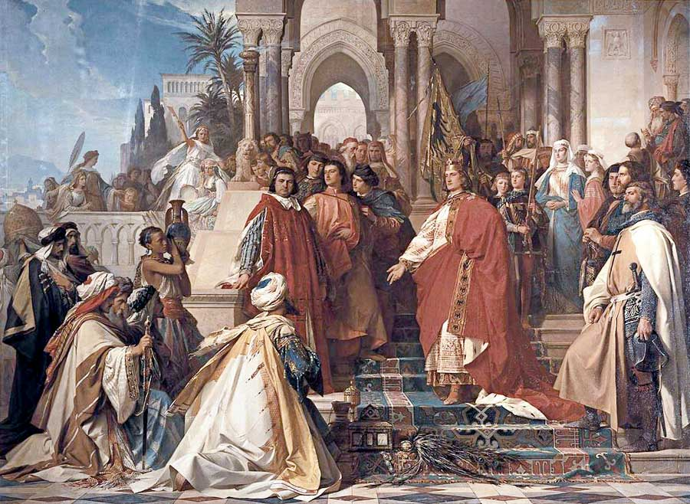
Holy Roman Emperor Frederick II excommunicated by Pope Gregory IX for disobeying.

Slide 16
Restoration
Who does it?
Galatians 6:1 “Brothers, if anyone is caught in any transgression, you who are spiritual should restore him in a spirit of gentleness. Keep watch on yourself, lest you too be tempted.”
How do you determine who is ‘spiritual’?
“Lest you too be tempted”? What?

Slide 17
Principles for Reconciliation
Grace.
Colossians 4:6 “Let your speech always be gracious, seasoned with salt, so that you may know how you ought to answer each person.”
The right answer in a wrong way?
Ephesians 4:26-27 “Be angry and do not sin; do not let the sun go down on your anger, [27] and give no opportunity to the devil.”

Slide 18
Principles for Reconciliation
Truth.
Ephesians 4:15 “Rather, speaking the truth in love, we are to grow up in every way into him who is the head, into Christ.”
Would it be different if phrased: “speaking love in truth”?

Slide 19
Conclusion
Hebrews 12:14 “Strive for peace with everyone, and for the holiness without which no one will see the Lord.”

Slide 21
Conflict in the Church
www.mackeynaz.org

